Slide 1
Agenda
Project Management Methodology
Systems Development Lifecycles

Slide 2
Project Success
Under what conditions is a project deemed to have been successful?
At or under budget
At or ahead of schedule
All required features and benefits
Stakeholder satisfaction
Project outcomes achieved
Other?

Slide 3
Project Management Methodology

Slide 4
Project Management Methodology
A methodology describes the methods, tools, and techniques used by an organization to manage its projects from beginning to end
Draws upon internal and external process assets
Project Management Office (PMO)
Different for every organization
Typically includes organizational roles and responsibilities (e.g. Sales)
Identifies a step by step approach for managing organizational projects

Slide 5
Project Management Plan
A project management plan defines how a project is executed, monitored/controlled, and closed.
Defines the methods, tools and techniques used by an organization to manage a single project
Describes how the work will be performed

Slide 6
Systems Development Lifecycles
Planned Approach
Sequential approach whereby a detailed plan and product specification for creating the entire finished product are developed up-front
Good for stable environment with well known requirements
Iterative/Hybrid
Moderately adaptive approach with requirements defined up-front creating the entire finished product are developed up-front
Good for environments with moderate levels of change and some known requirements
Agile
Highly adaptive approach whereby the emphasis is on delivering finished, working software in time intervals no greater than 30 days
Good for rapidly changing environments with few known requirements
Agile Manifesto, Getting Real, US Digital Services Playbook

Slide 7
Systems Development Life Cycles

Slide 8
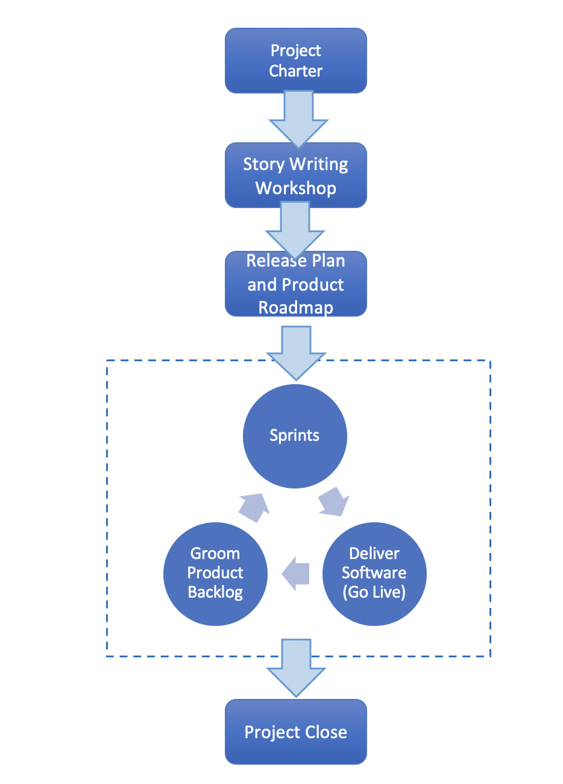
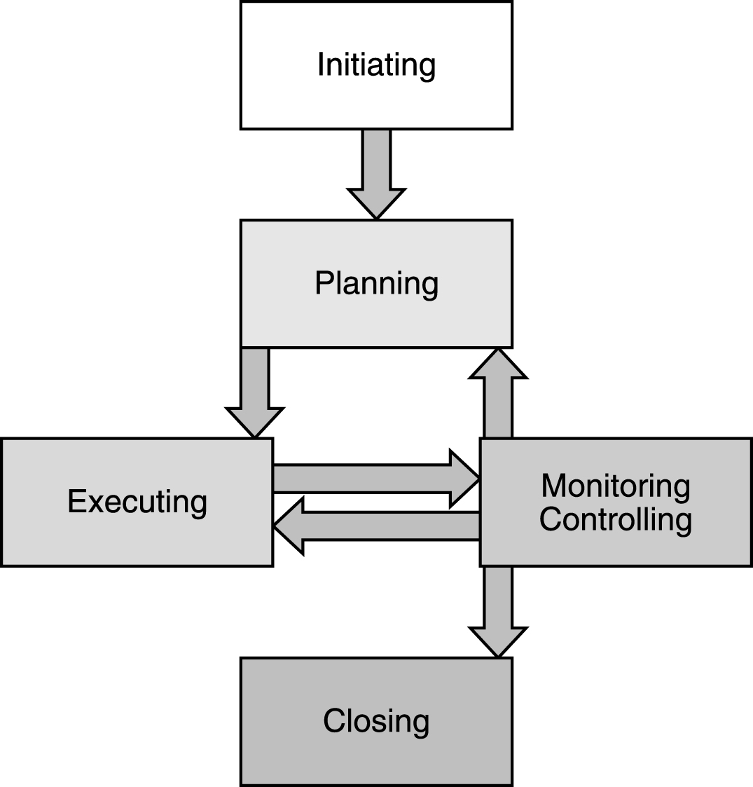
Understanding the Project Lifecycle
Planned – PMI PMBOK
Adaptive - Scrum/Agile
PMP in Depth: Project Management Professional Study Guide for PMP and CAPM Exams

Slide 9
Systems Development Lifecycles
Planned
Waterfall
V-Shaped
Iterative
Prototype
RAD
Incremental
Spiral
Agile
Scrum
SAFe (Scaled Agile Framework)
Kanban
Disciplined Agile Development

Slide 10
Class Waterfall Model with Feedback
Concept Exploration
System Exploration
Requirements
Design
Implementation
Installation
Operations and Support
Maintenance
Retirement
Source: Adapted from Quality Software Project Management by Futrell, Shafer, and Shafer

Slide 11
Waterfall
Strengths
Well known
Ordered approach for handling complexity
Milestones
Weaknesses
Linearity – hard to go back
Lack of user involvement
Excessive documentation

Slide 12
V-Shaped
Project and Requirements Planning
Production Operation and Maintenance
Product Requirements and Specifications Analysis
System and Acceptance Testing
Architecture of High Level Design
Integration and Testing
Detailed Design
Unit Testing
Coding
Source: Adapted from Quality Software Project Management by Futrell, Shafer, and Shafer

Slide 13
V-Shaped
Strengths
Emphasizes verification and validation of all deliverables
Weaknesses
Does not handle iterations
Hard to handle changes in requirements

Slide 14
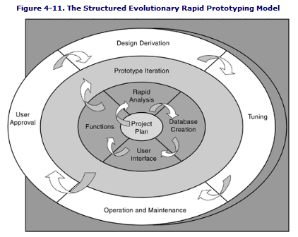
Prototyping
Quality Software Project Management by Futrell, Shafer, and Shafer

Slide 15
Prototyping
Strengths
End user can see the system requirements
End user provides feedback
Helps avoid miscommunication
Weaknesses
System performance may suffer
May continue indefinitely
Poor documentation

Slide 16
Rapid Application Development
Level of User Involvement
Construction
Development Effort
User Description
Requirements Planning
Cutover
Time
Quality Software Project Management by Futrell, Shafer, and Shafer

Slide 17
Rapid Application Development
Strengths
Reduced cycle time – 60 days or less
Increased customer involvement and feedback
Reuse
Weaknesses
Requires high skill-level
System must be modular
Cost and completion date are not known up-front

Slide 18
The Incremental/Iterative Model
Increment 1
System Feasibility
Detailed Design
Software Requirements
Coding
Verification
Integration
Product Design
Implementation
Operation and Maintenance
Increment 2
Detailed Design
Increment 3
Coding
Detailed Design
Integration
Coding
Implementation
Integration
Operation and Maintenance
Implementation
Operation and Maintenance
Source: Adapted from Quality Software Project Management by Futrell, Shafer, and Shafer

Slide 19
Incremental/Iterative
Strengths
Operational product delivered with each increment
Divide and conquer
User feedback and involvement
Weaknesses
Requires good planning and design
Need well defined interfaces
Tendency to push hard problems until the end

Slide 20
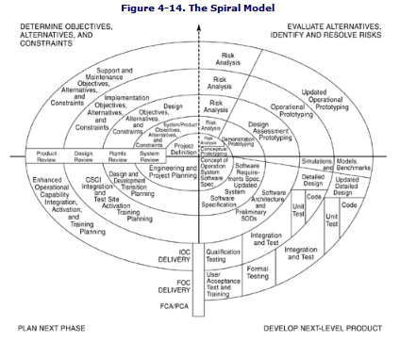
The Spiral Model
Quality Software Project Management by Futrell, Shafer, and Shafer

Slide 21
Spiral Model
Strengths
Identifies risks early
Users feedback and involvement
High risk functions implemented first
Weaknesses
Expensive for low risk projects
Risk assessment expertise required
May continue indefinitely

Slide 22
Scrum
Timebox (typically 2 weeks)

Slide 23
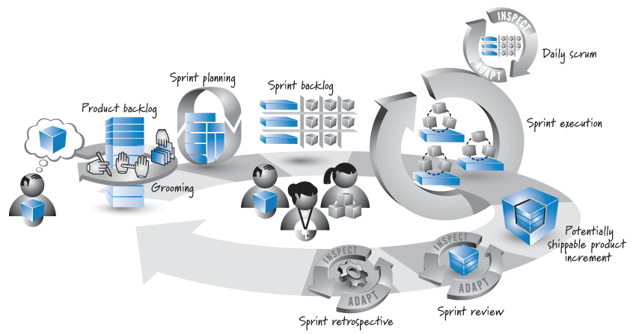
Scrum Sprint
Source: Essential Scrum by Kenneth S. Rubin p. 17
Notes:
Agile software development emphasizes agility and the ability to adapt to changing conditions
Time boxed deliverables
Limited up-front planning, frequent product deliverables, limited documentation, and quick daily meetings with team and customers
Agile Manifesto

Slide 24
Scrum
Strengths
Ability to adapt to change
User involvement and feedback
Collaboration
Time boxed deliverables – 1 week to 30 days
Focus on idle work not idle workers
Weaknesses
May not be suited for large development teams
Limited documentation

Slide 25
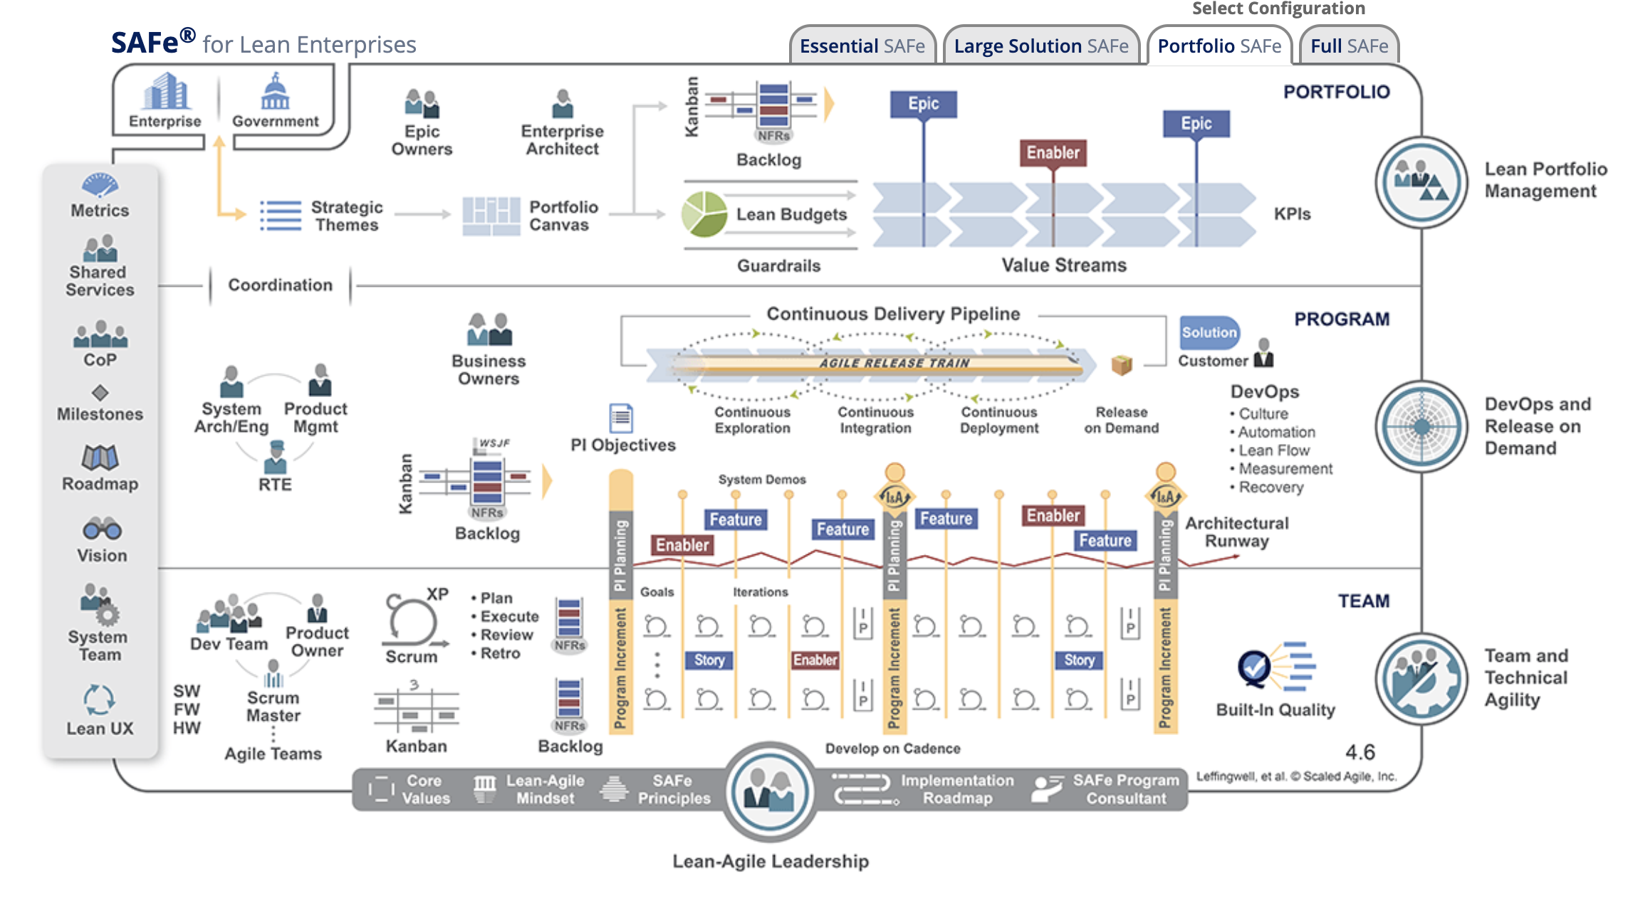
Scaled Agile Framework (SAFe)
Source: https://www.scaledagileframework.com/#

Slide 26
SAFe
Strengths
Designed with the enterprise in mind
Ability to adapt to change
User involvement and feedback
Collaboration
Time boxed deliverables – 1 week to 30 days
Focus on idle work not idle workers
Weaknesses
Limited documentation
Difficult to implement

Slide 27
Kanban Board
To Do
In Progress
Done
Sprint Backlog
User Story 2
User Story 3
User Story 4
User Story 1

Slide 28
Kanban Board
Strengths
Helps a team Focus on what is important
Weaknesses
Not a formal methodology but a tracking tool instead

Slide 29
Disciplined Agile Development (DAD)
Organized into 4 Layers
Foundation
Disciplined DevOps
Value Streams
Disciplined Agile Enterprise
Source: https://www.pmi.org/disciplined-agile/introduction-to-disciplined-agile

Slide 30
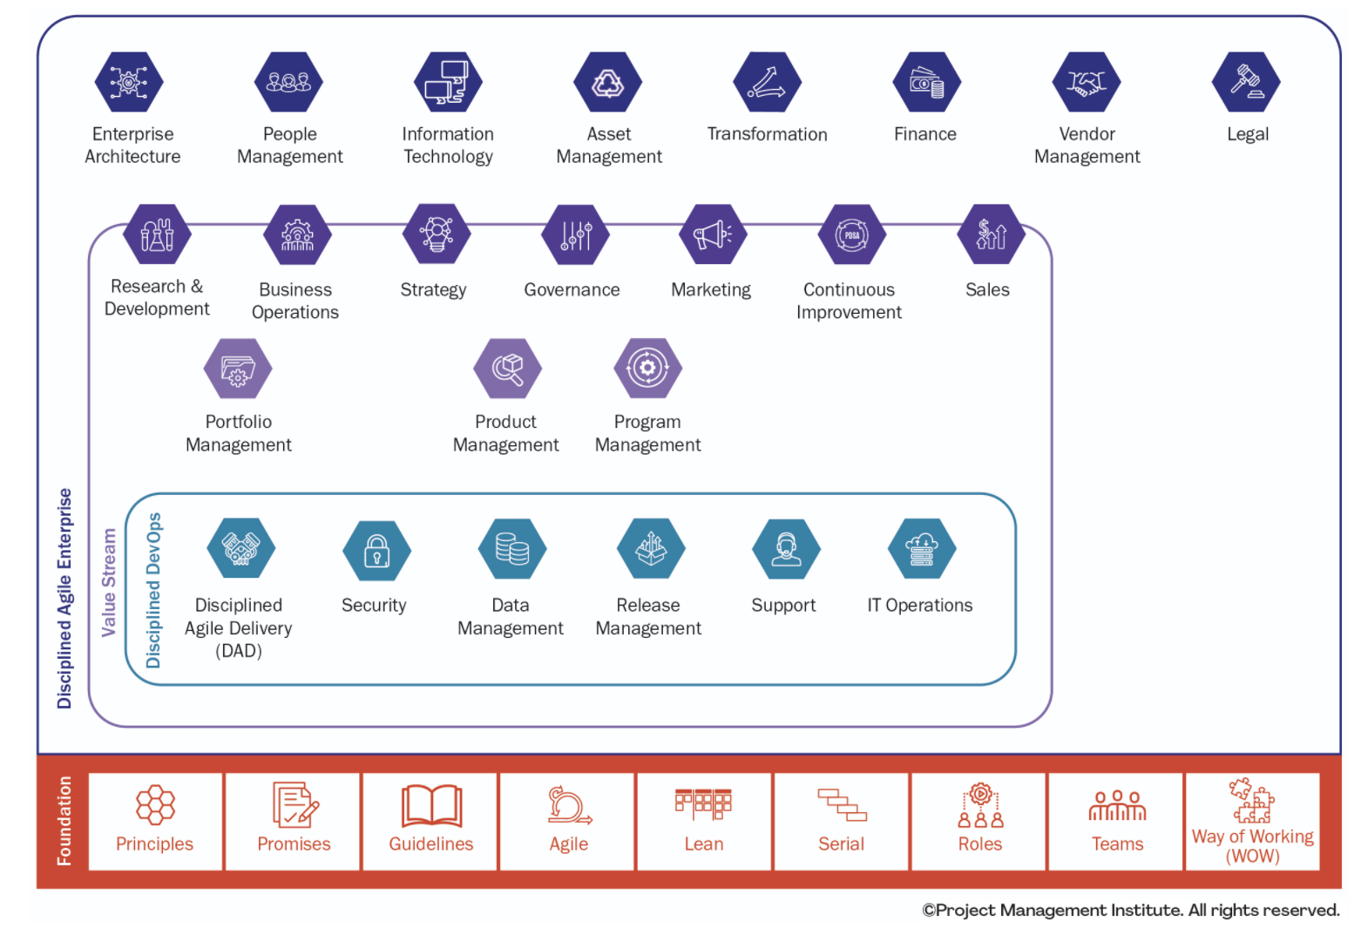
Disciplined Agile Development (DA)
Source: https://www.pmi.org/disciplined-agile/introduction-to-disciplined-agile

Slide 31
DA
Strengths
Organized approach to agile across the enterprise
Weaknesses
Too much structure
Doesn’t always follow agile principles (e.g. lightweight documentation, focus on writing code, short timeboxes, embrace change and uncertainty, self management)

Slide 32
Exercise
Selecting an Appropriate Systems Development Lifecycle

